Slide 1
Microsoft Interview Coaching Program
Week 1 - Intro

Slide 2
Agenda
Coding Interview Approach
TEBOW IT
TDD
Hands-on Exercise
Homework

Slide 3
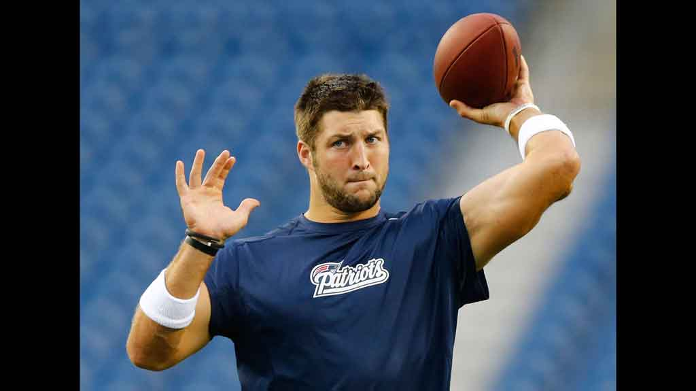
This is Tim Tebow. You will never forget him after today.

Slide 4
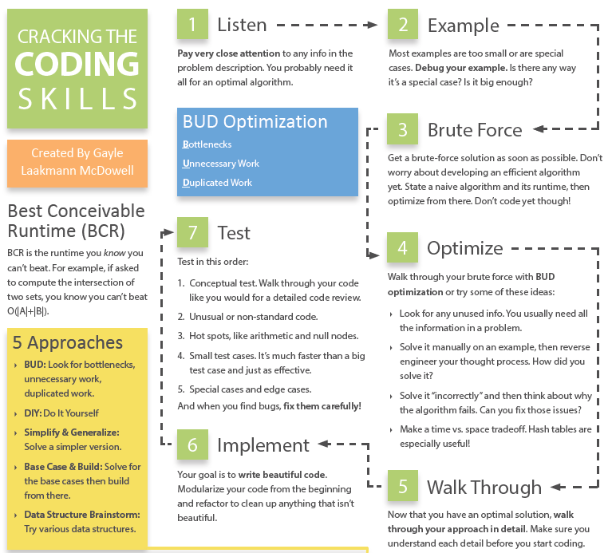
Coding Interview Approach

Slide 5
TEBOW IT
Talk
Examples
Brute Force
Optimize
Walk Through
Implement
Test
Notes:
Not uncommon to spend most of the time in the first part!

Slide 6
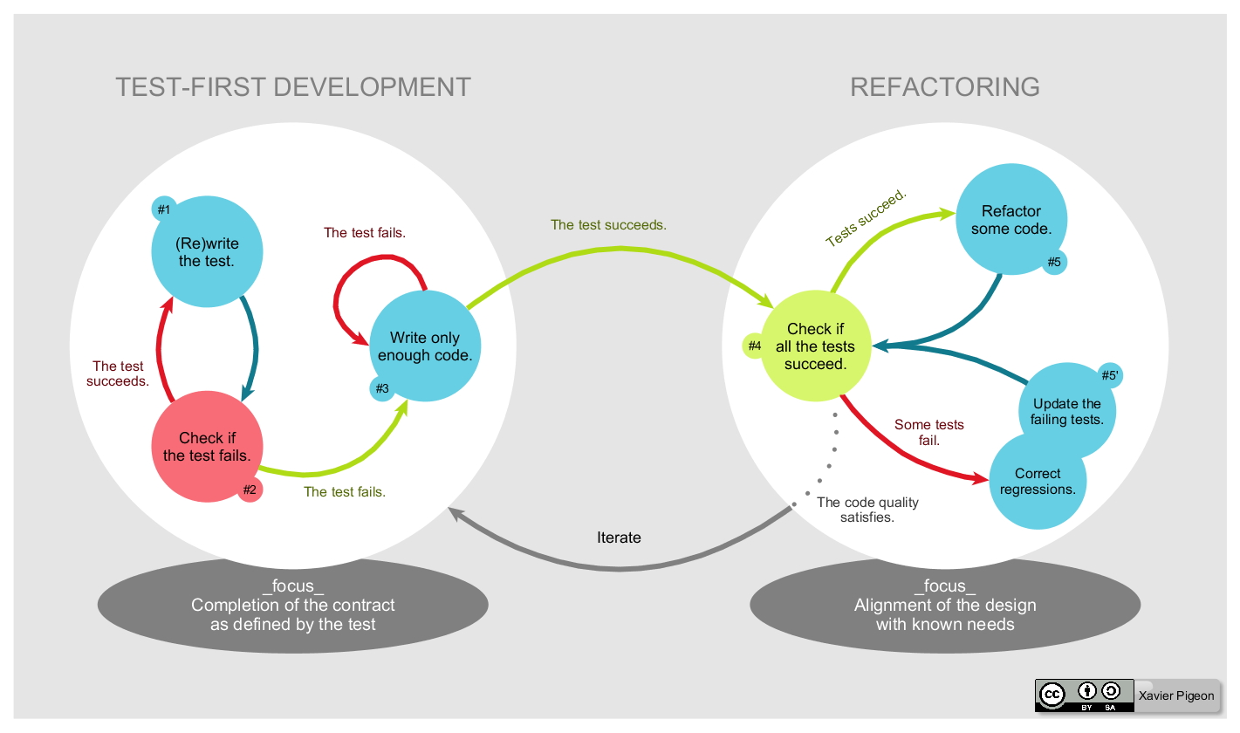
TDD – Test Driven Development
Notes:
Never erase your test cases!!

Slide 7
What is “good code”?
Correct
Efficient
Simple
Readable
Maintainable

Slide 8
Exercise: Integer Palindrome with a twist
A Palindrome is a number that reads the same forward as it does in reverse. For example, 12321 is a palindrome because it reads the same going from left to right as it does going right to left. Most numbers can be made into palindromes by taking the original number, reversing the digits, then adding the original number to the reversed digits. If that number isn’t a palindrome, then repeat the same process until you reach a palindrome. Most numbers can be made into palindromes by repeating this process, but some numbers don’t converge. During this process, if the number becomes larger than 1,000,000 and still doesn’t form a palindrome, then return false.

Slide 9
T – Talk (/Listen/Clarify)
The interviewer might not give you all the information you need
It’s easy to misunderstand what they are asking you to do
Ask questions! Interviewers expect it!
What should be taken in as a parameter?
What should be returned?
Do I need to handle incorrect input?
What about negative numbers?
Return true/false or the number that was a palindrome?
If original number is palindrome, return?

Slide 10
E – Examples (/Test/TDD)
Sample Input | Class | Out (is Palindrome?)
3 | Single digit numbers | Yes
444 | Numbers with same digits | Yes
121 | Numbers < 1,000,000 that are already palindromes | Yes
999,998 | Boundary/edge case | No
21 (21 + 12 = 33) | Number that requires reversing and adding to become a palindrome | Yes
1234 | Sum of original digit + reverse <= 9 | Yes
 | Odd/even number of digits
90,089 (90,089 + 98,009 = 188,098, 188,098 + 890,881 = 1,078,979) | Numbers that will never converge to palindrome | No
19 (19 + 91 = 110, 110 + 11 = 121) | Number that requires reversing and adding more than once to become a palindrome | Yes
1,000,0001 | Invalid input (n< 0 or n > 1,000,000) | No

Slide 11
B – Brute Force
Convert number to a string
Check if string is palindrome
If not, reverse the string
Convert reversed string back to integer
Add original number + reverse
Check if input is valid

Slide 12
O - Optimize
What are the shortcomings of your current solution?
What is its runtime?
What are the storage requirements?
Lots of conversions to/from integer/string. Can we do it without strings?
Can you do it with/without recursion?

Slide 13
W – Walk Through (Stage 1)
Call IsPalindrome(int n)
If not, call Reverse(int n)
Add original number + reverse
Check if number is in range

Slide 14
Int Reverse(int n)
Brainstorm: How do you reverse an integer?

Slide 15
Bool IsPalindrome(int n)
Brainstorm: How can you tell whether a number is a palindrome or not?
Hint: can you use the results of Reverse()? Recall the problem definition: “A Palindrome is a number that reads the same forward as it does in reverse.”

Slide 16
W – Walk Through (Stage 2)
Store the results of Reverse(int n)
Call IsPalindrome(int original, int reversed)
If not palindrome, add original number + reverse
Check if number is in range
Notes:
Notice we modified our diagram after thinking through the implementation of each building block

Slide 17
IT – Implement and Test
DEMO – github, Visual Studio, NCrunch continuous test runner

Slide 18
Exercise: TEBOW IT
Crowd source the following TEBOW IT slides with the students for a practice question

Slide 19
T – Talk (/Listen/Clarify)

Slide 20
E – Examples (/Test/TDD)
Sample Input | Equivalence Class | Output

Slide 21
B – Brute Force

Slide 22
O - Optimize

Slide 23
W – Walk Through

Slide 24
I - Implement

Slide 25
T - Test

Slide 26
Homework Assignment
Week 1 Assignment – we’ll review this in Week 2
Caesar Cipher
Stretch goals
atoi and itoa
Challenge: Reverse Parse Multi-Byte

Slide 27
Caesar Cipher
The code you will write is based on the “Caesar Cipher” where each letter is shifted a certain number of places left or right through the alphabet. The alphabet is treated as being circular so that the first letter follows after the last letter, and the last letter precedes the first letter. These ideas will be applied separately to uppercase letters, lower case letters, and digits. For example, with a shift of 1, ‘A’ becomes ‘B’, ‘Z’ becomes ‘A’, ‘a’ becomes ‘b’, ‘z’ becomes ‘a’, ‘0’ becomes ‘1’, ‘9’ becomes ‘0’. Spaces, punctuation, and any other symbols are unaffected in this scheme. Your task is to write a function to encrypt a string using this Caesar Cipher.
INPUT FORMAT
Your function will take an input string that begins with a number representing the shift. The number will be in the range -1000000000 to 1000000000 (negative 1 billion to 1 billion). The number is followed by a colon (‘:’). The rest of the line consists of a string of 1 to 200 arbitrary characters and represents a fragment of the text to be encrypted.
OUTPUT FORMAT
Output will be the corresponding encrypted text fragment
SAMPLE INPUT:
1:some text
SAMPLE OUTPUT:
tpnf ufyu

Slide 28
ATOI and ITOA
int atoi(string input) – convert a string to an integer
string itoa(int input) – convert an integer to a string

Slide 29
Reverse Parse Multi-Byte
You are to implement a function with the following prototype
int NumChars(char* begin, char* end)
The purpose of the function is to determine whether the last character in the buffer defined as the bytes between begin and end is English or Japanese. Japanese characters are two bytes long and always have a 1 in the high bit of the high byte. The low byte of a Japanese character can have either 1 or 0 in the high bit. English characters are one byte long and always have a 0 in the high bit. The function is expected to return the following:
2 if last character is Japanese (two bytes)
1 if last character is English (one byte)
0 if the data in the buffer is malformed

Slide 30
Helpful Resources
Cracking the Coding Interview
We’re going to try to buy this book for you!
Microsoft College Code Competition
Code Complete, 2nd edition – “good code”

Slide 31

Week 1 Takeaway
Don’t miss out on a job because you forgot to TEBOW IT!

